Slide 1
CREATE A WEBSITE FOR FOOD Web Programming - Team Project
Members in our Team:
A
B
C

Slide 2
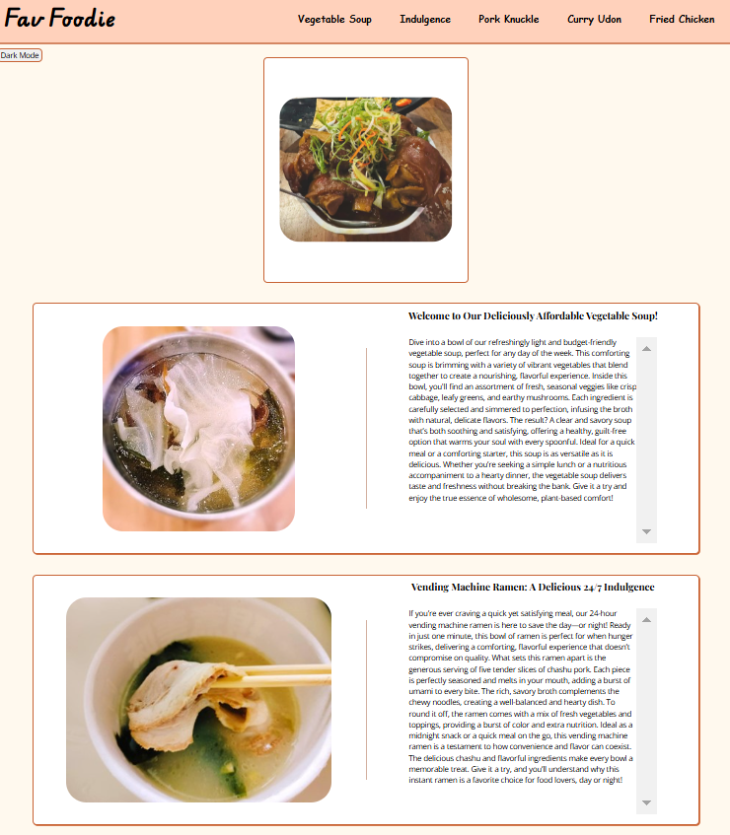
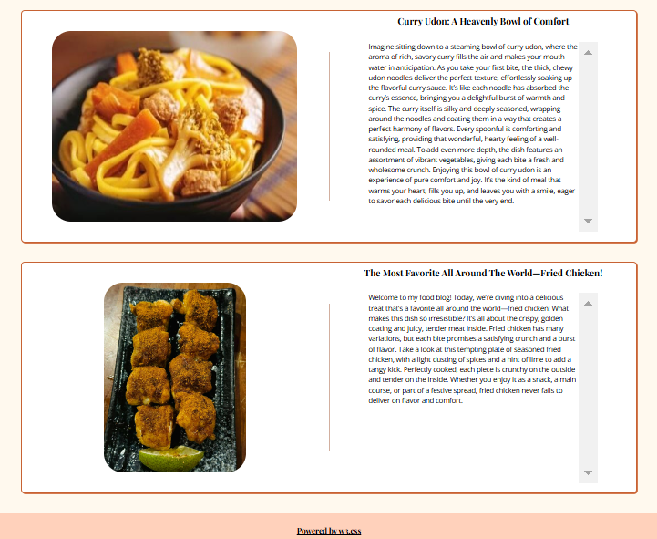
WEBSITE PRERVIEWS:

Slide 3
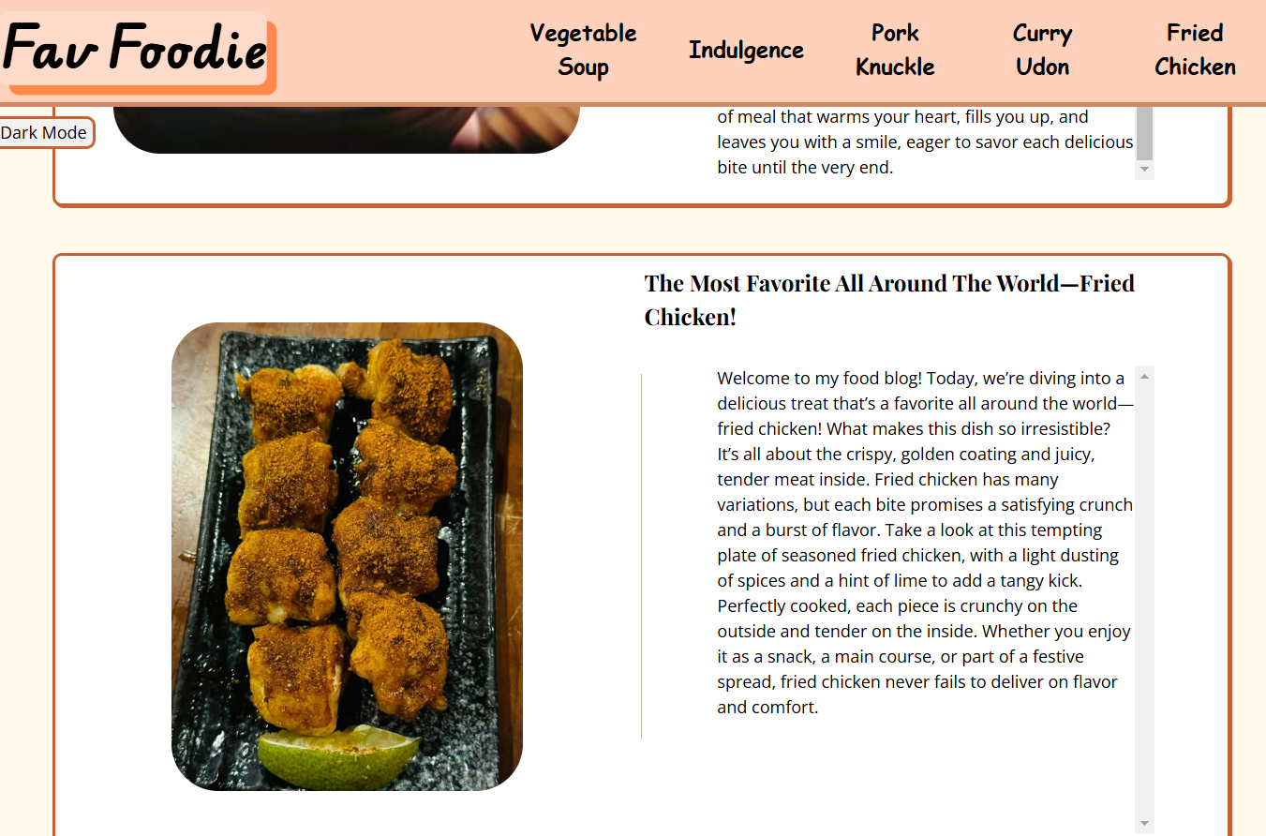
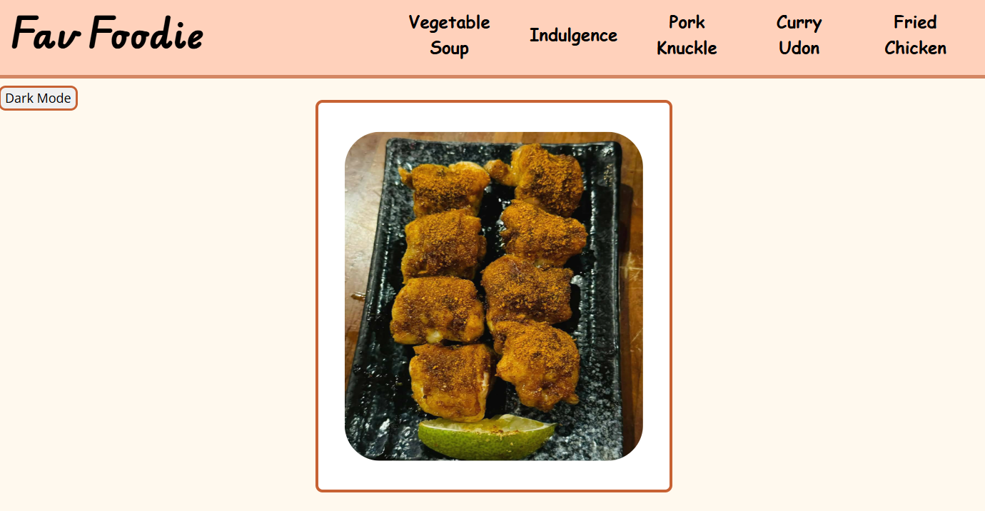
function(1): to top
Go to the top !!
Press here!!

Slide 4
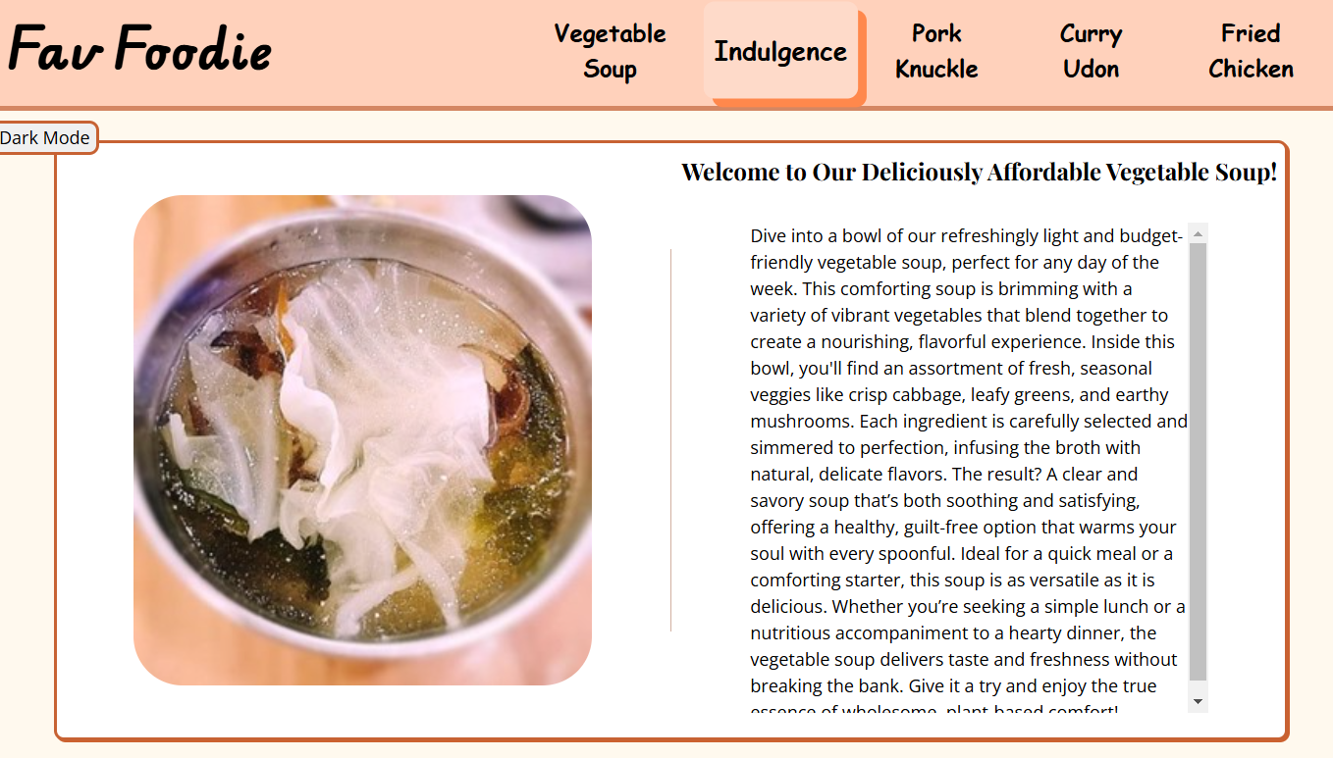
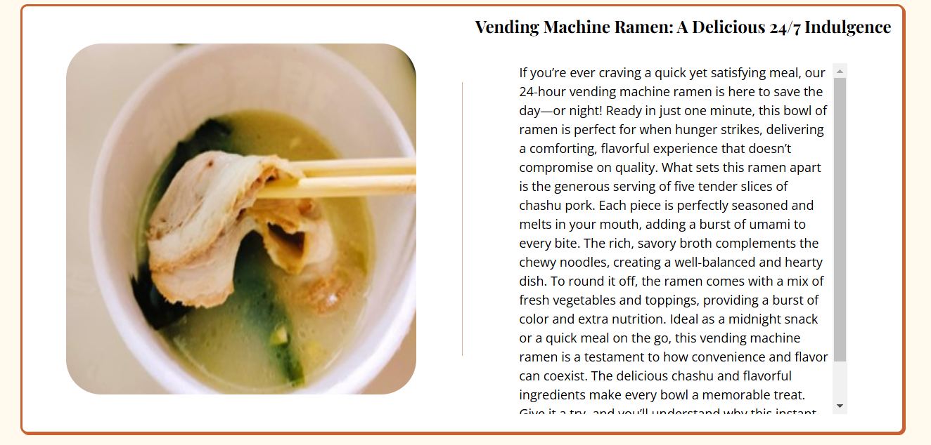
function(2): to each food
Press here!!
Go to any food section you want !!

Slide 5
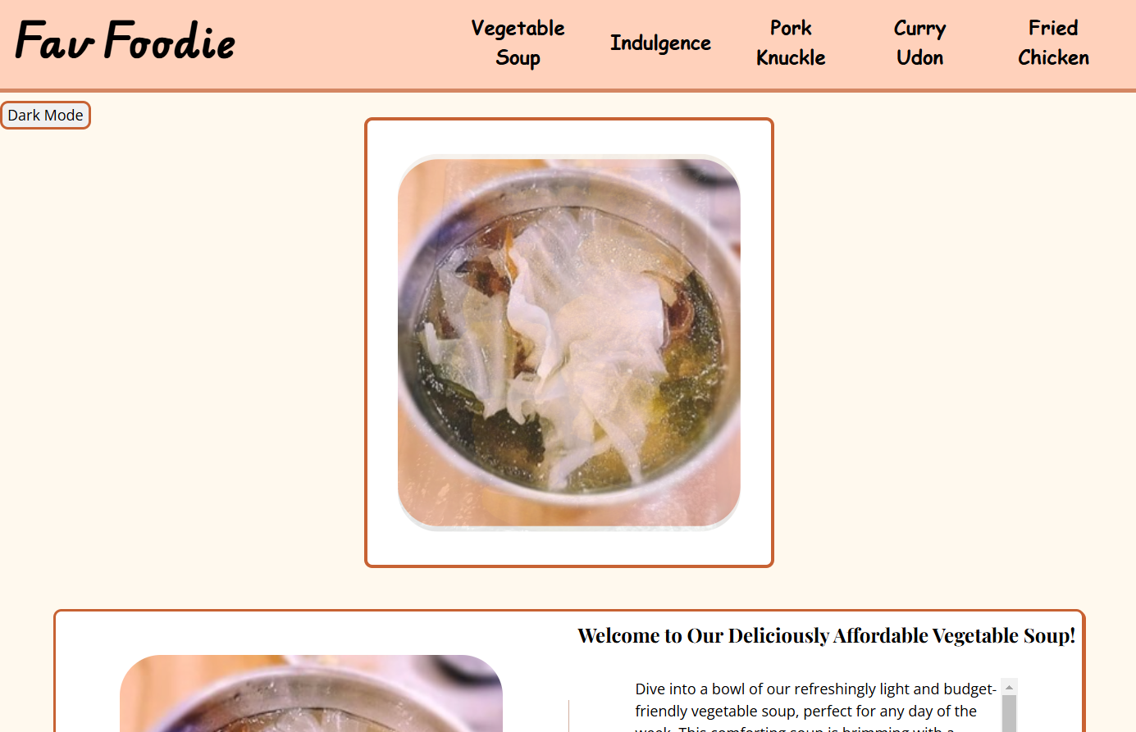
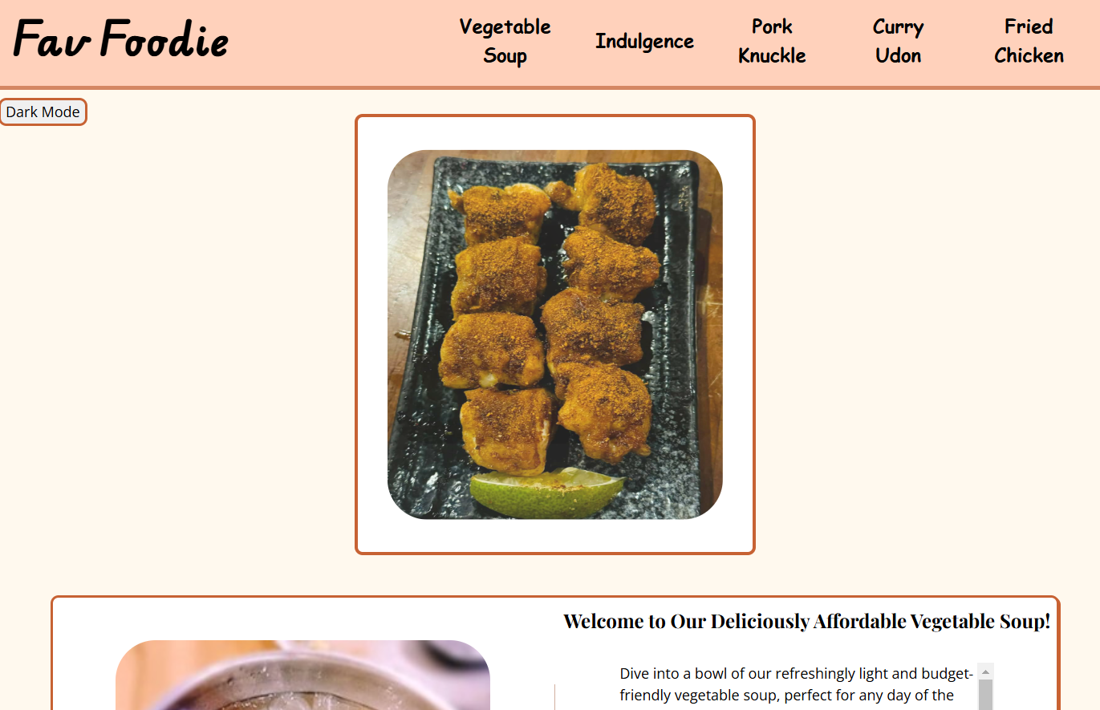
function(3): changing picture
Change over time !!

Slide 6
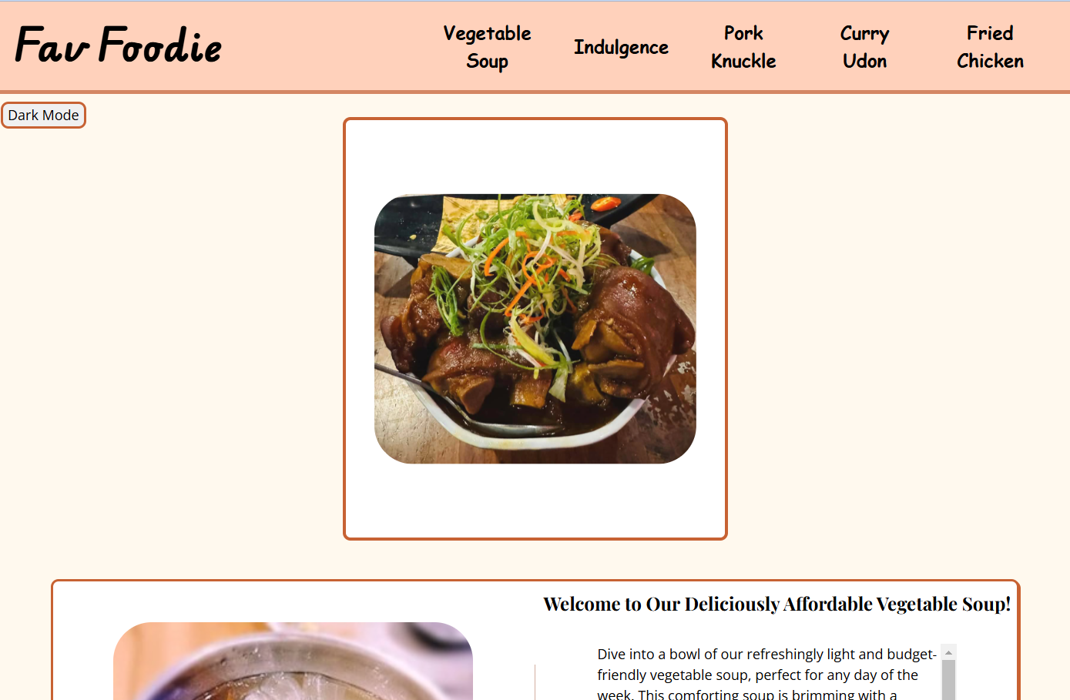
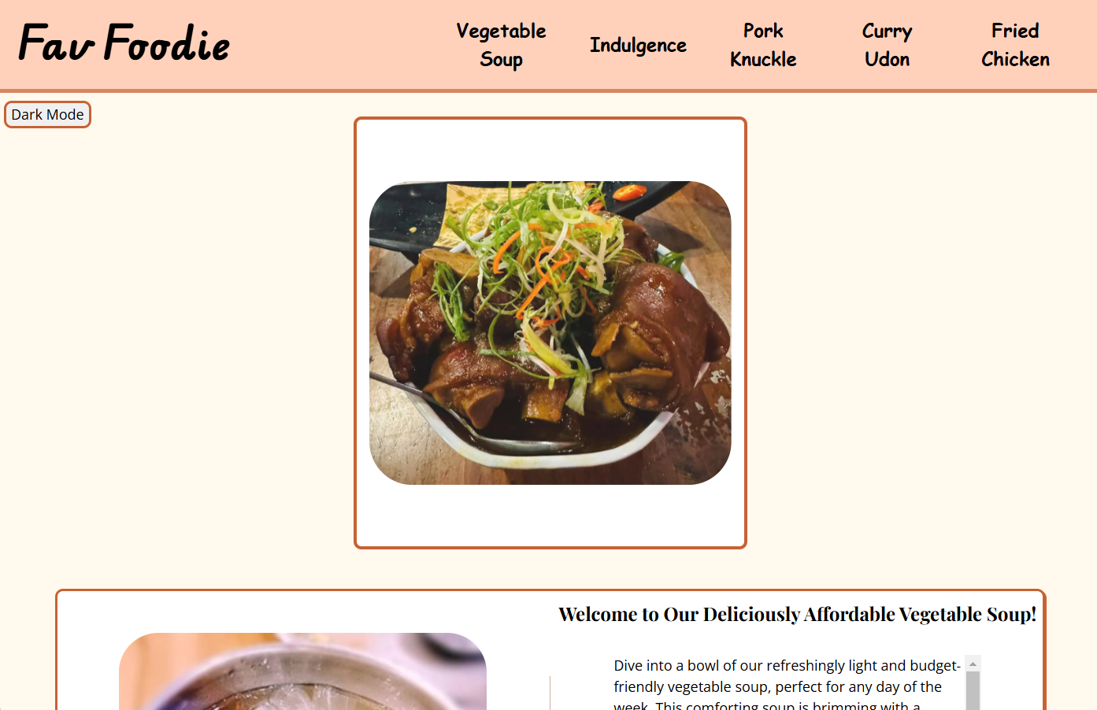

function(4): enlarged picture

Slide 7
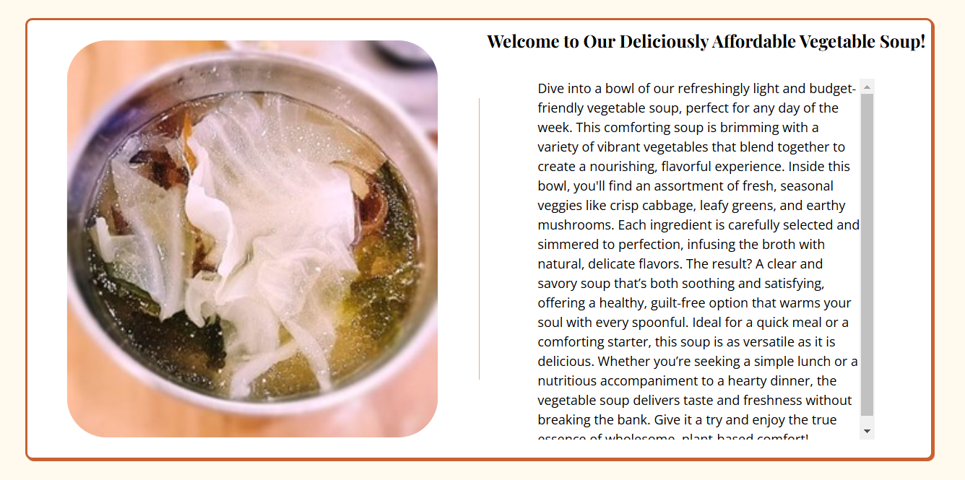
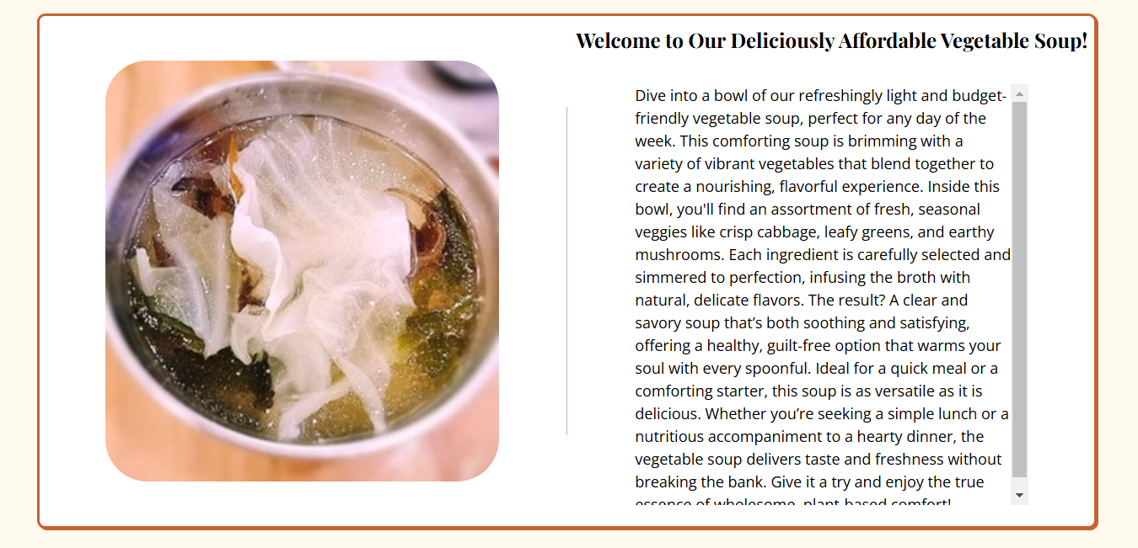
function(4):

Slide 8
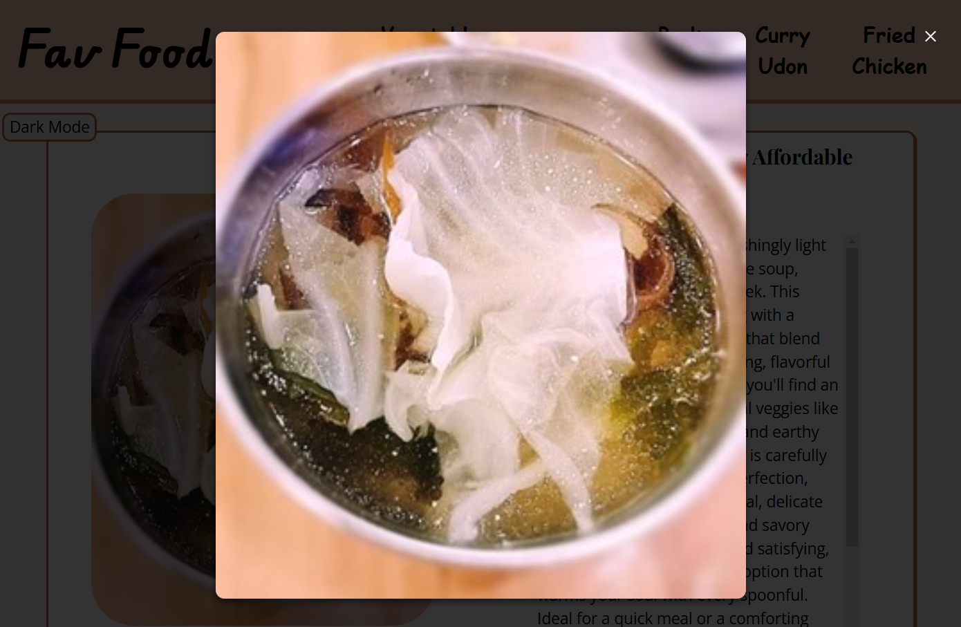
function(4): click picture

Slide 9
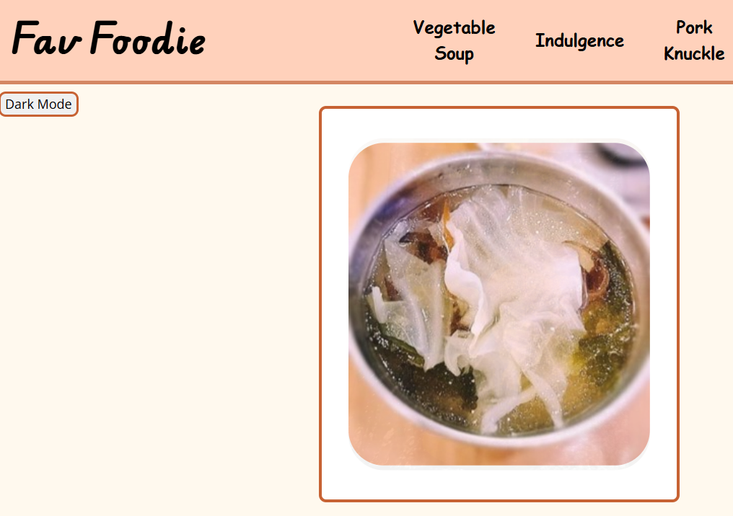
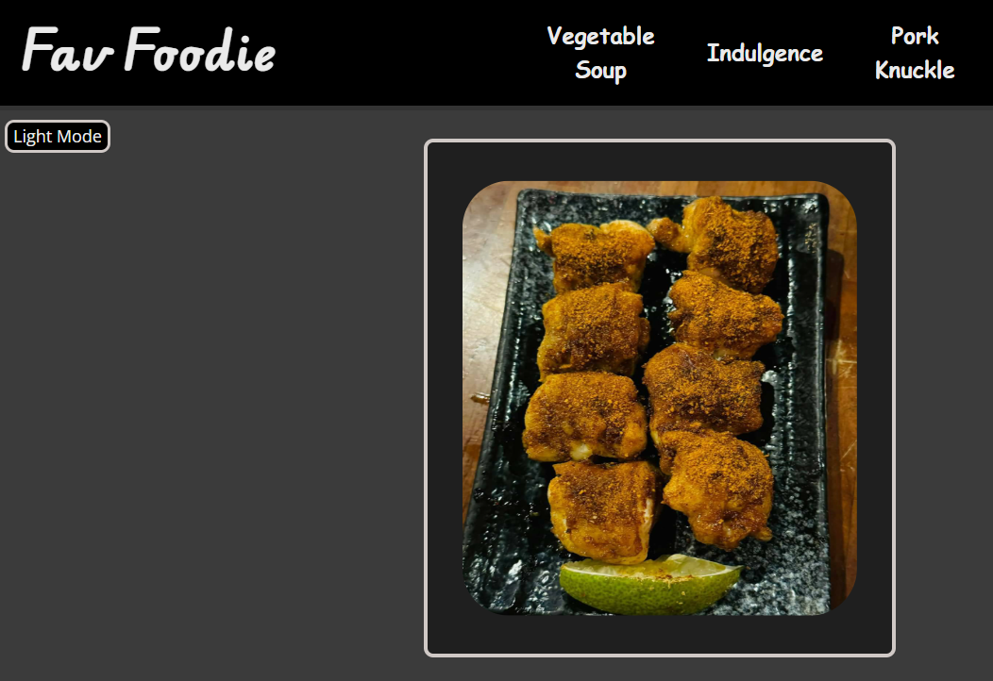
function(5): dark mode

Slide 10
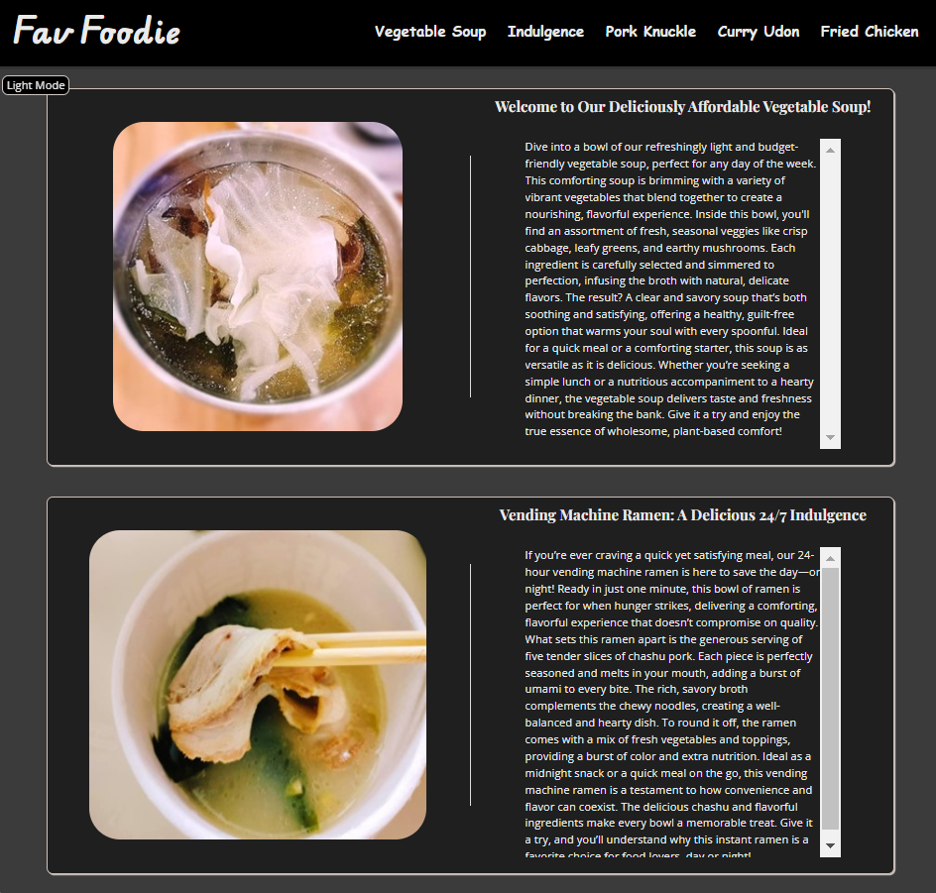
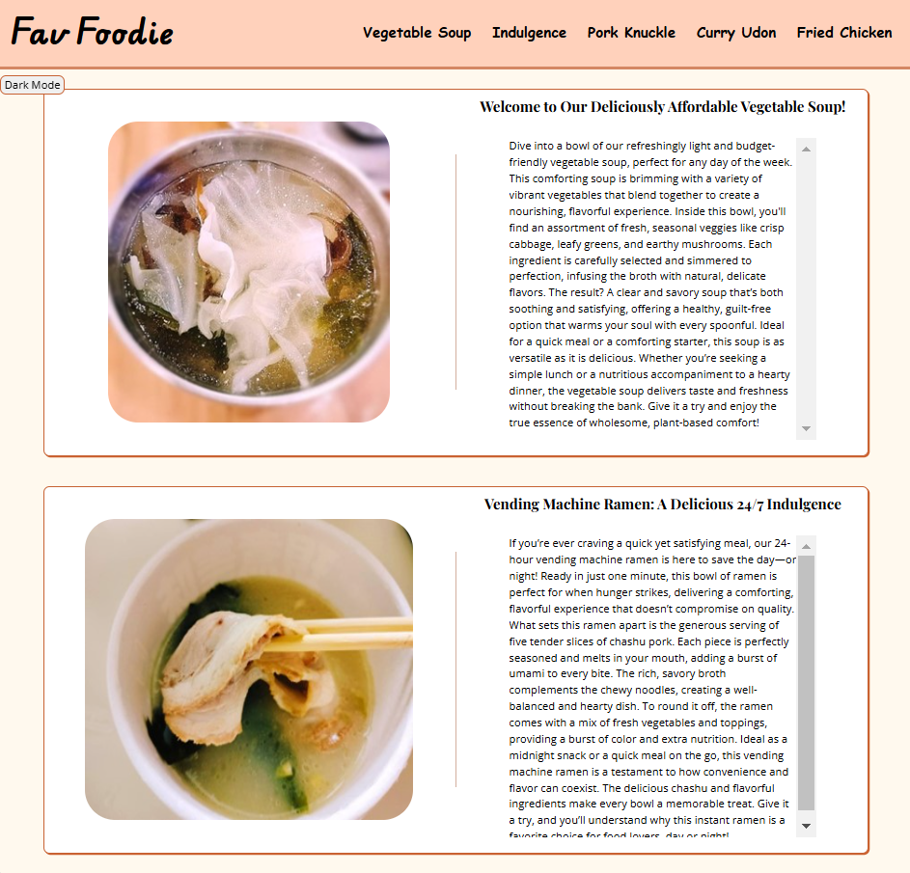
function(5):
Vs.

Slide 11
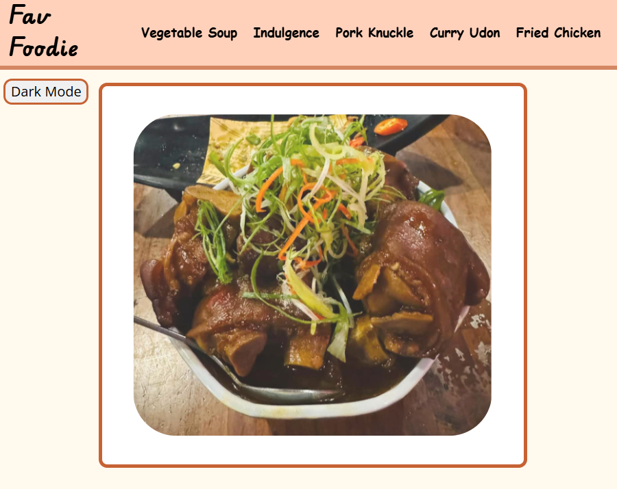
function(6): not device-picking
Mobile:
Smaller text and picture.
Control picture size with picture width setting.
.Css file’s code is written in mobile_style.css.
Etc.

Slide 12
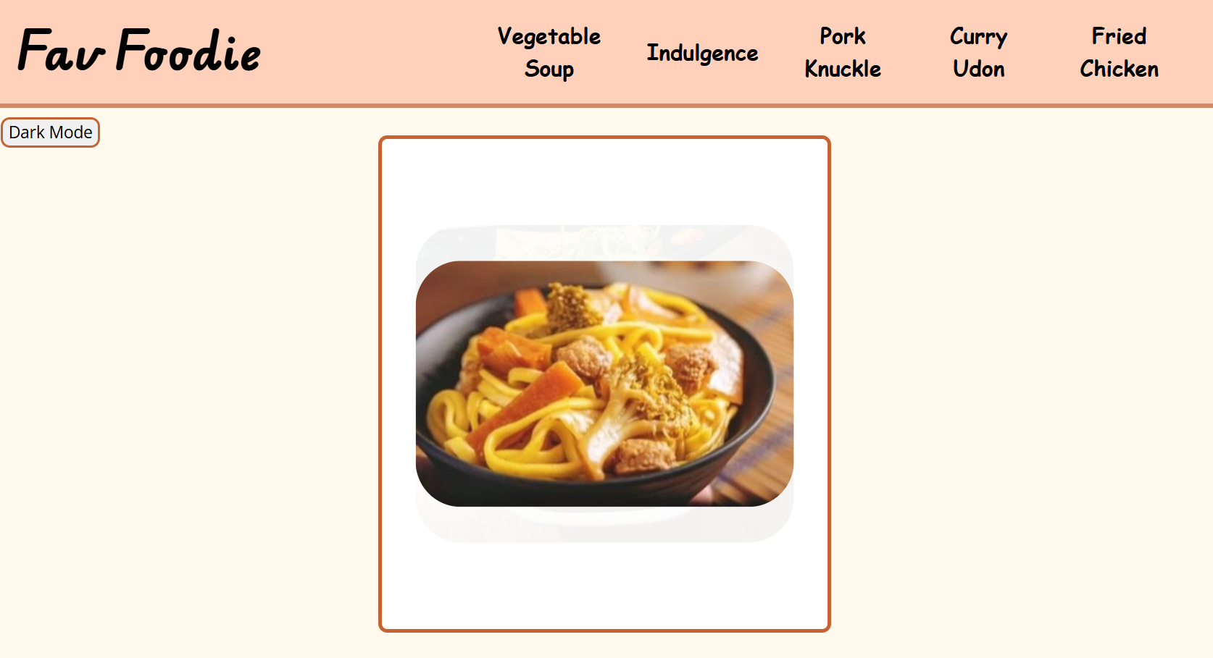
function(6): not device-picking
PC:
Larger text and picture.
Control picture size with picture height setting.
.Css file’s code is written in pc_style.css.
Etc.

Slide 13
consideration: coding
Designate different style to different device:
Use two .css file to achieve this function.
But, if the two device need same .css effect:
We can put that in common.css.

Slide 14
Team member contribution:
A:
add “dark-mode” button.
B:
add “to top”, “to section” button.
add “enlarge” function to pictures.
Power Point create
C:
design the website’s html , css and js structure.
Demo video Create

Slide 15
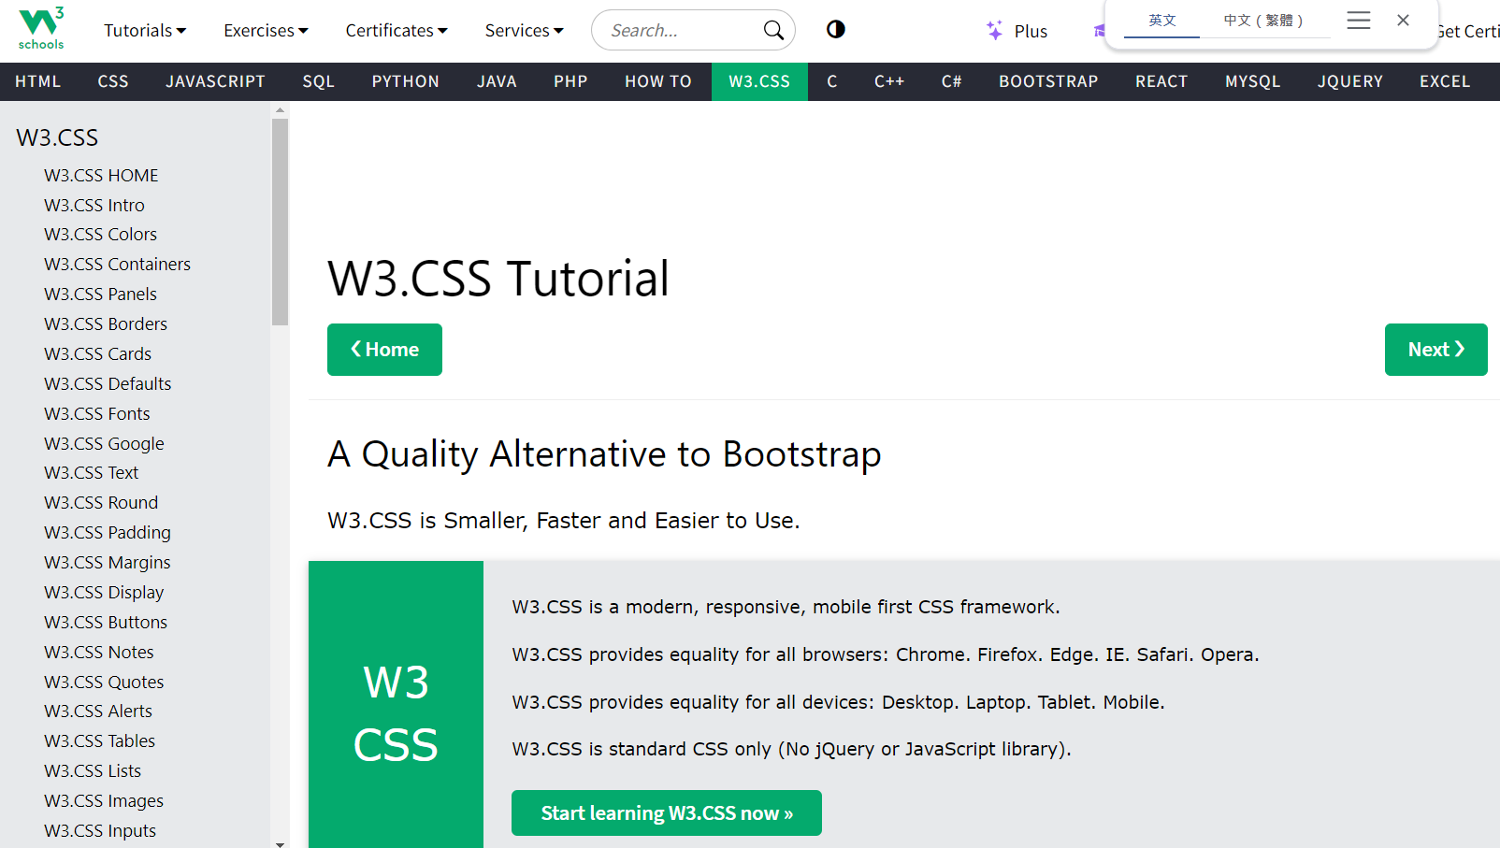
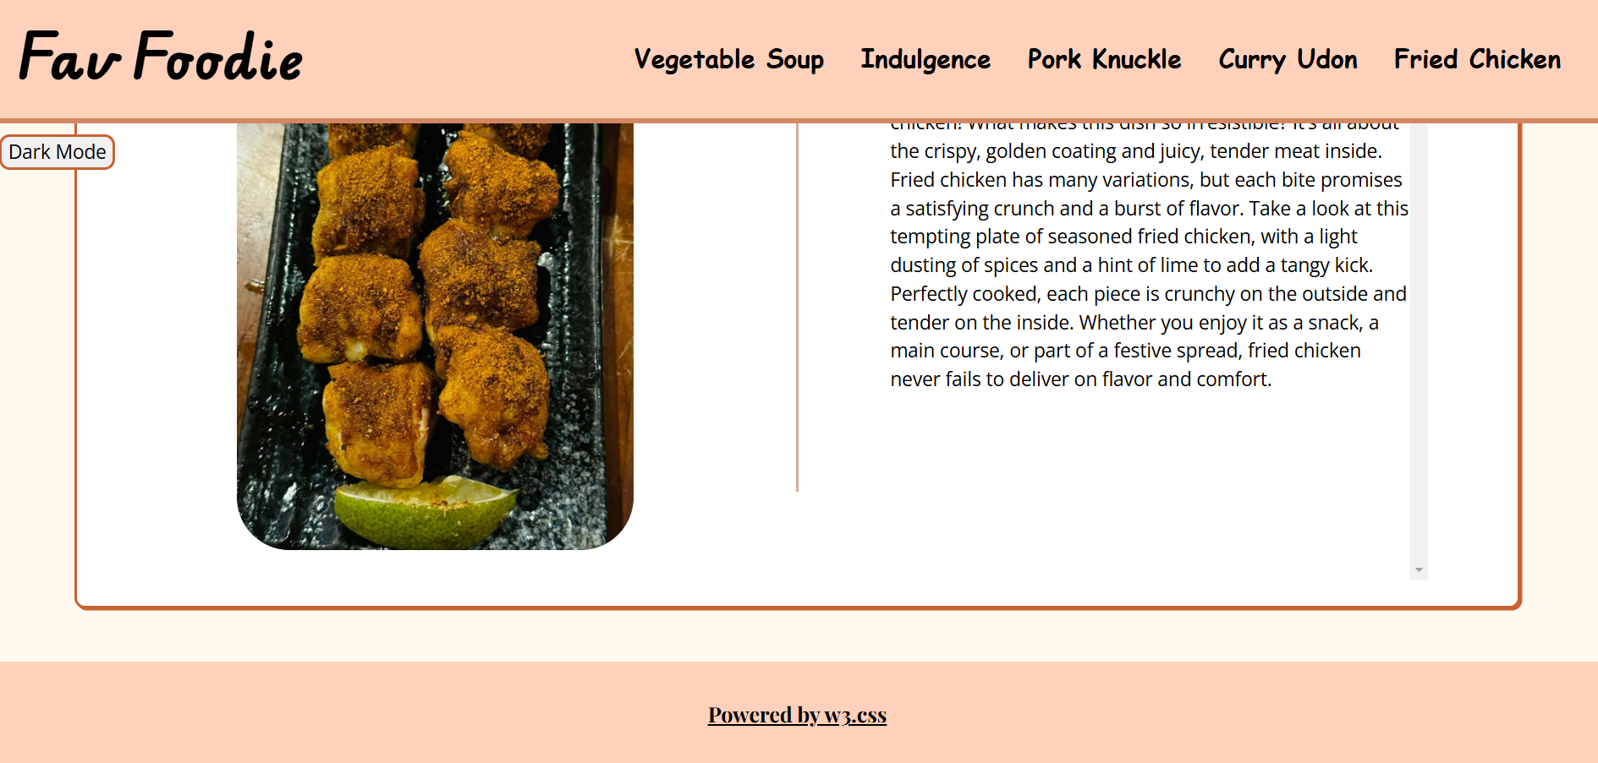
reference:
W3.css.com: https://www.w3schools.com/w3css/defaulT.asp

Slide 16
THE END

